Slide 1

CMR College of Engineering & Technology
(UGC Autonomous)
Accredited by NAAC with “A+” Grade
Kandlakoya, Medchal Road, Hyderabad-501401
Major Project
TEAM - 29
Analyzing customer sentiments on E-Tail applications using NLP
Under the guidance of
Dr.Y.Ambica
Head Of Department
Dr. P. Sruthi
Name of the students & Roll No’s.
20H51A6647 - TEEGALA JUSTIN ROY
20H51A6687 - PALLE SAI TEJA
20H51A6693 - V.UDAY KIRAN REDDY
20H51A66A1 - B.HARSHITH

Slide 2
The comments and reviews of a product on an e-commerce platform play a crucial role in influencing potential buyers and shaping the reputation of both the product and the platform itself.
To extract comments and reviews from a web page the web scraping plays a major role.Web scraping is a technique used to extract data from websites. It involves fetching and parsing the HTML of a web page to extract the desired information.
NLP plays a crucial role in converting these reviews and comments into positive negative and neutral.
Sentiment analysis, a subfield of NLP, focuses on determining the sentiment expressed in a piece of text.
Raw text data undergoes preprocessing steps, including tokenization, stemming, and removing stop words, to prepare it for analysis.
The project findings are presented through data visualizations, making it easier for stakeholders to comprehend customer sentiment trends and feedback.
Introduction

Slide 3
Analysing Product reviews:Analysing the customer reviews on a product and classifying them whether as negative or positive or neutral.
Product Improvement: Identify areas for product or service improvement based on customer feedback and sentiments. This can contribute to enhancing customer satisfaction and loyalty.
Visual representation of Key reviews: Generating a visual report Wordcloud based on the key words from the reviews like(good, quality, best,nice,etc.) on that particular product.
Customer Service Improvement: Identify common issues in customer feedback to improve customer service processes. This can lead to better customer experiences and increased satisfaction.
Objectives

Slide 4
Existing Systems
Various NLP libraries: One of the existing systems Various NLP libraries like NLTK, spaCy, and TextBlob can be used to perform sentiment analysis and text processing on customer comments and reviews.
Custom Data Scraping Tools: Developers and researchers often create custom web scraping scripts or tools to extract customer comments and reviews from e-commerce websites like Flipkart.
Sentiment Analysis APIs: Services like the Google Cloud Natural Language API, IBM Watson NLU, and Amazon Comprehend provide pre-built sentiment analysis capabilities that can be integrated into projects.
Text Analytics Software: Commercial text analytics software solutions, such as Lexalytics, RapidMiner, and MonkeyLearn, can be used for sentiment analysis and keyword extraction.

Slide 5
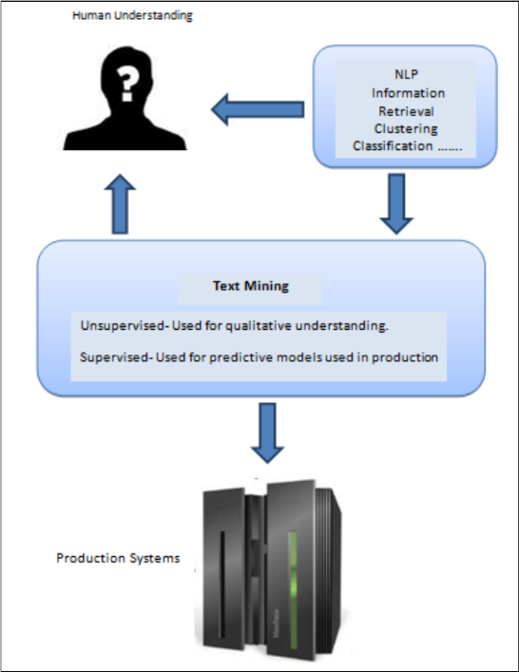
1) Text Analysis Software:-https://www.researchgate.net/publication/359352715_Text_Analytics_An_Application_of_Text_Mining
DRAWBACKS
Integration with Existing Systems.
Expensive and Complexity.
Text analytics software overview

Slide 6
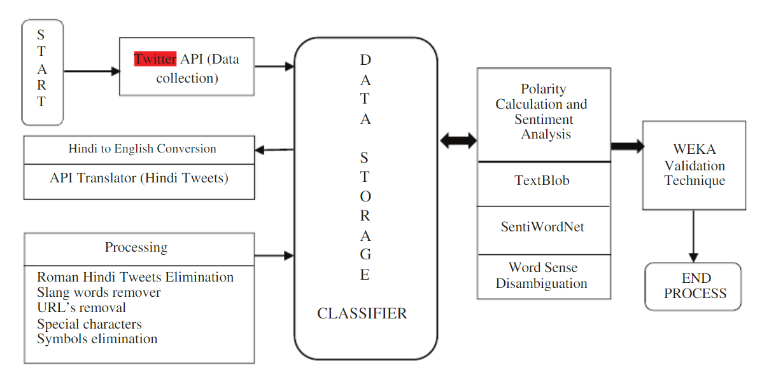
2) Sentimental Analysis API’s
https://www.researchgate.net/publication/365476065_Sentiment_Analysis_with_Tweets_Behaviour_in_Twitter_Streaming_API
Sentimental analysis Using Streaming API on twitter
DRAWBACKS
Some basic prior knowledge about API’s should be known.
Scalability Challenges:Depending on the API provider, there may be limitations on the number of requests per minute.
Usage Costs: API usage often comes with costs, high-volume usage can lead to significant charges.
Data Exposure: Using a sentiment analysis API requires sending text data to a third-party service, raising concerns about data privacy and security.

Slide 7
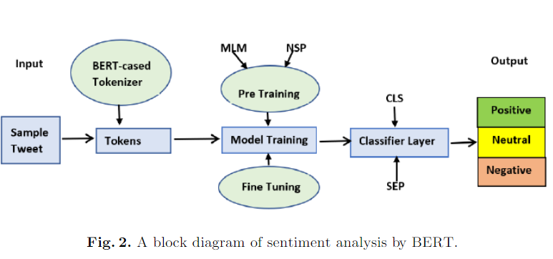
3) Sentimental Analysis Using BERT https://www.researchgate.net/publication/351648377_Sentiment_Analysis_of_COVID-19_Tweets_How_Does_BERT_Perform
High Resource Requirements: BERT is a large and complex model, requiring significant computational resources for training and inference.
The BERT-base model requires more than 400MB of memory and takes a few seconds for inference on CPU instances.
Inference Latency: Refers to the time it takes for a machine learning model to process input data and generate predictions
A block diagram of sentiment analysis by BERT

Slide 8
Unlike the above approaches, we are using recent sentimental analysis tools and beautiful soup for web scraping.
By using Wordcloud and NLTK libraries for sentimental analysis on the comments and reviews which were extracted from ecommerce applications using beautiful soup.
We eliminate the stop words in those comments and collects only the main keywords in those comments.
We use those keywords for analyzing a product on the e-commerce application, and finding the insights like whether to go for purchasing the product, or not to purchase, no.of positive reviews and no.of negative reviews will be known and displayed on screen in a pictorial representation.
This will ensure the buyer in purchasing a product and make the e-commerce market easy to analyze which type of products are loved by the customers.
Proposed System

Slide 9
Why NLTK?
Comprehensive Toolkit: NLTK is a comprehensive toolkit that covers a wide range of NLP tasks, including tokenization, stemming, tagging, parsing, and more.
Text Corpora and Resources: NLTK includes a variety of text corpora and lexical resources, making it easy to access datasets for experimenting with different NLP techniques.
Open Source and Free: NLTK is open source and freely available, making it accessible to a wide range of users. This can be particularly advantageous for academic and research projects with budget constraints.
Why Beautiful soup?
Unlike Scrapy it is easy to use.
It helps to extract data from HTML pages and java script where as Http requests is used to extract data only from HTML pages.
PyQuery is used only for JQuery pages which is not suitable for HTML pages.

Slide 10
Module
1. User Interface (UI) Module:
Create web pages for input, analysis results, and visualization.
2. Data Ingestion Module:
Collect and preprocess customer reviews for sentiment analysis.
Set up a mechanism to receive and validate user input from the UI.
3. Sentiment Analysis Module:
Develop and deploy the sentiment analysis models for processing customer reviews.
Implement NLP algorithms for sentiment analysis (Stemming,Tokenization,lemmatization,token to vector).
4. Results Presentation Module:
Display the analyzed sentiments, thematic insights, and correlations in a comprehensible format.
Design visualizations, such as charts and graphs, to represent sentiment distributions and topic trends.
Implement a dynamic results page that updates in real-time based on user input.
Ensure accessibility and responsiveness for a seamless user experience.
6. Deployment and Hosting Module:
Deploy the web application for public access.

Slide 11
ALGORITHM
W-D-SA-V-I
W = Web-Scraping ( URL, Web scraping library, Extracting reviews and metadata, Handling Pagination )
D = Data Preprocessing ( Remove special characters, and irrelevant information from the reviews, Tokenization, Stemming, and Lemmatization. )
SA = Sentimental Analysis ( Classification of reviews into negative, positive and analyzing ratings )
V = Visualization (Preparing report of the results as Word cloud or Plots)
I = Insights (Analyze the most frequently mentioned positive and negative aspects of the product. Track Changes Over Time )

Slide 12
LIBRARIES used:-
os
nltk
joblib
requests
numpy
from bs4 -> BeautifulSoup
urllib.request
matplotlib.pyplot
from nltk.corpus -> stopwords
from wordcloud -> WordCloud, STOPWORDS
from flask -> render_template,request
time

Slide 13
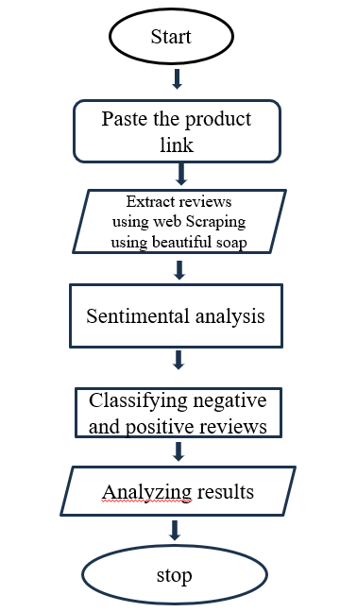
Flow Chart

Slide 14
Logistics:-
1)Beautiful-soup (Web Scraping)
2)NLTK library (sentimental analysis)
3)VS-Code (Platform)
4)Wordcloud, NLTK.corpus, Stopwords (to analyze reviews)
5)Python - Flask (Backend Framework)
Logistics
FUTURE SCOPE
1) Chrome extension
2) Machine learning on data sets
3)language translation

Slide 15
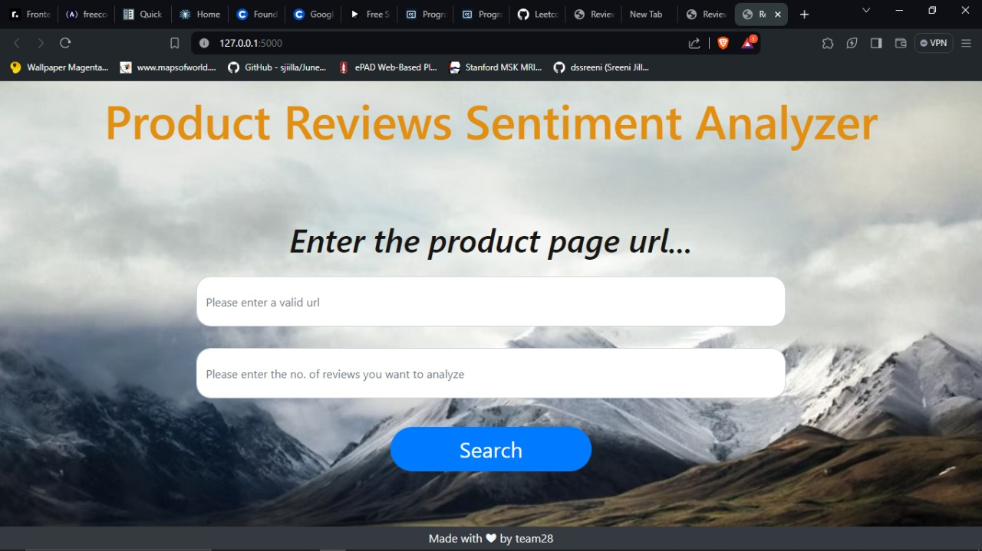
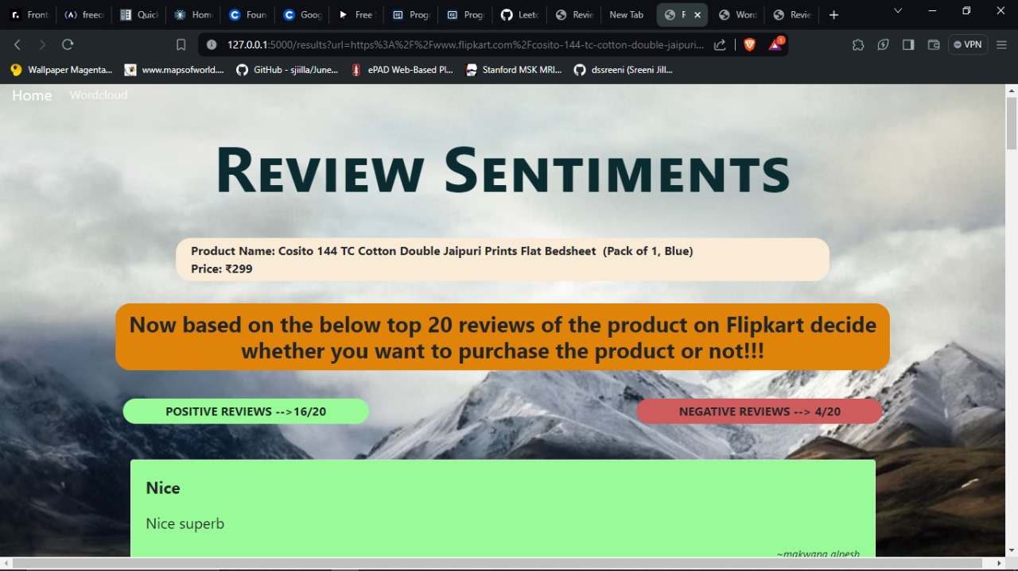
RESULTS
Home page
Result page

Slide 16
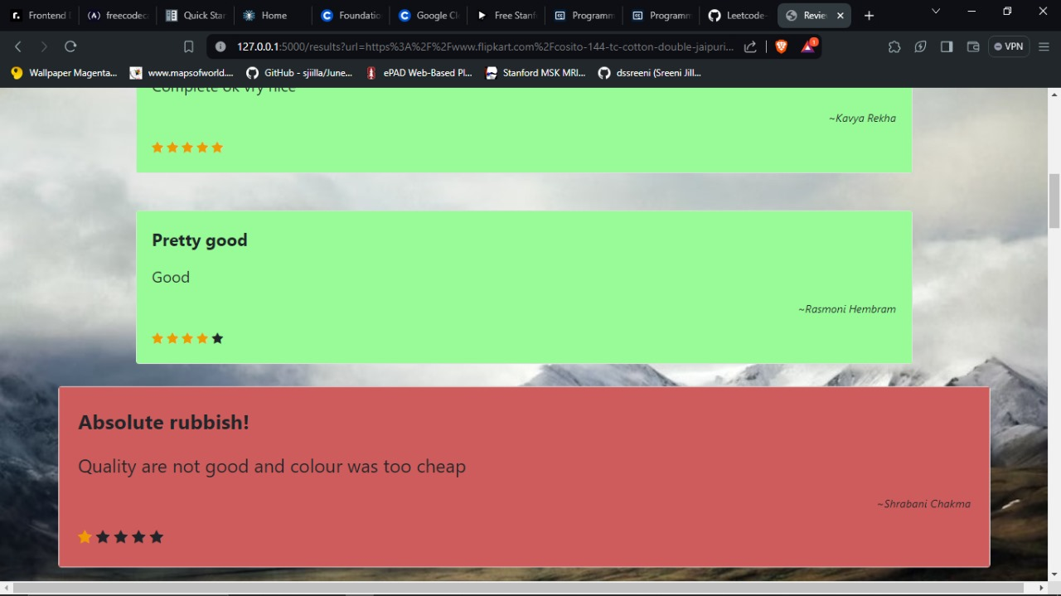
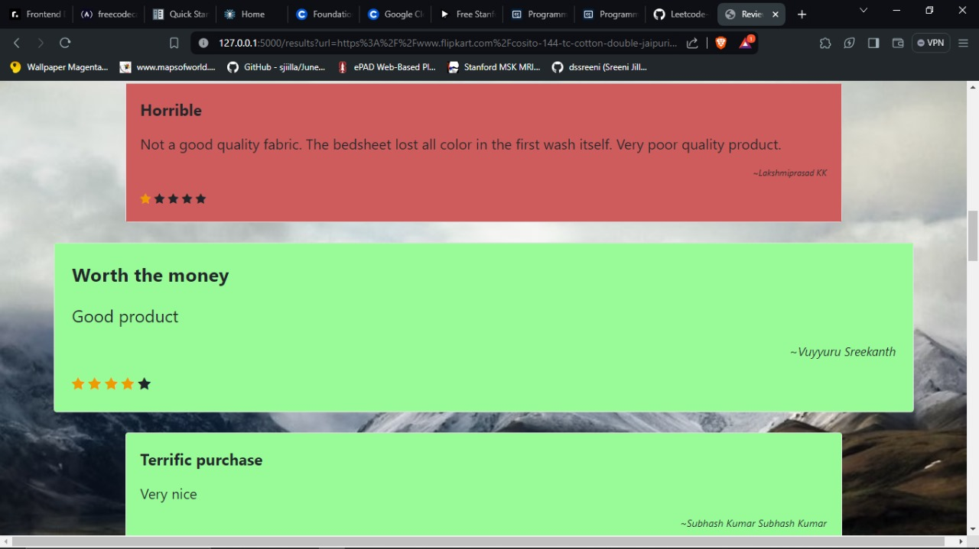
Displaying the reviews

Slide 17
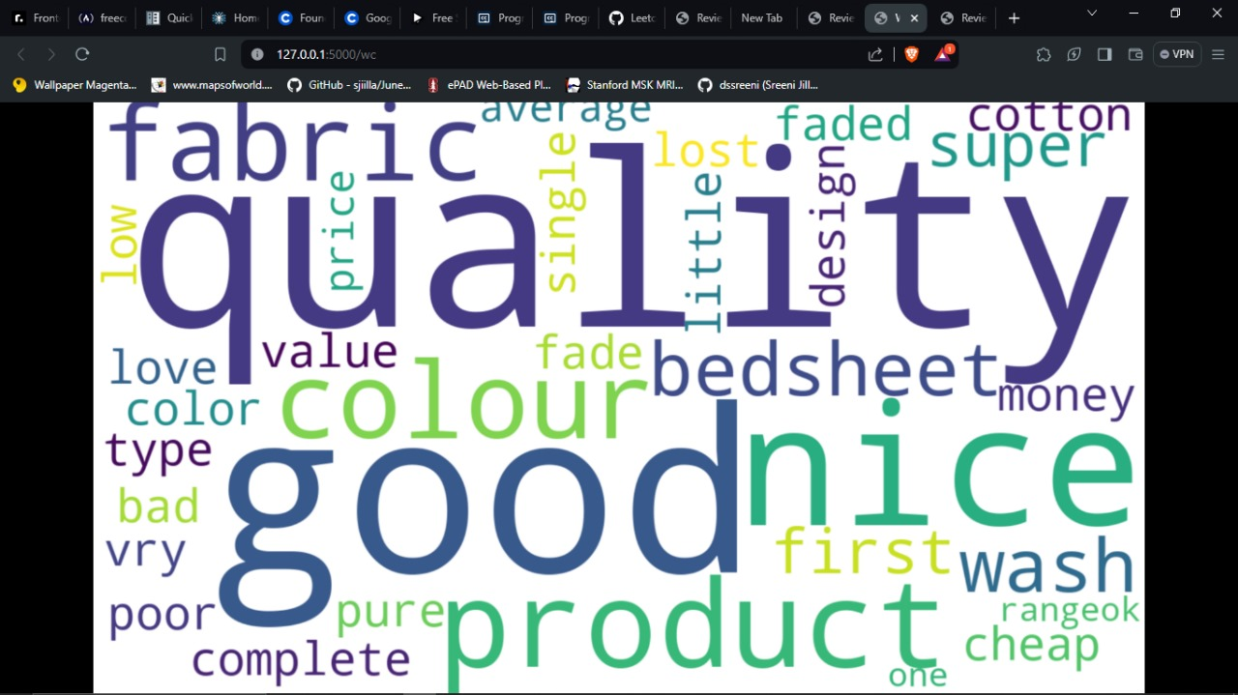
Generating WordCloud

Slide 18
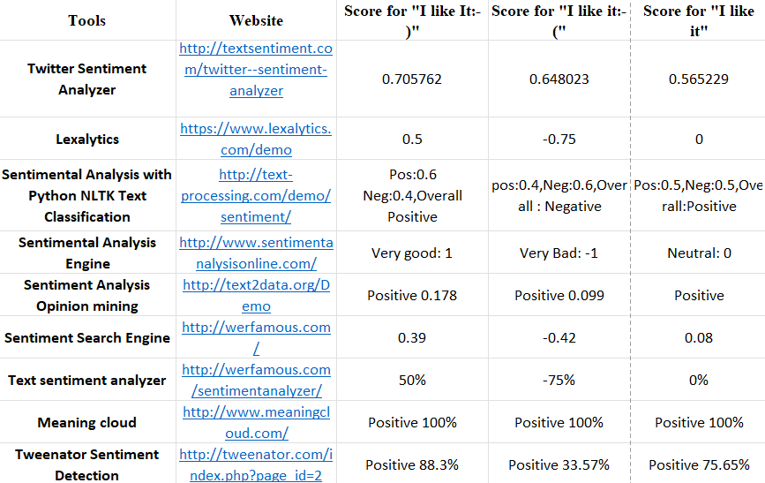
Comparing results of different sentimental analysis tools

Slide 19
Sentiment analysis using NLP is a powerful tool for extracting insights from textual data, especially in the context of customer reviews. As technology continues to advance, the application of sentiment analysis is likely to become more nuanced, accurate, and tailored to specific business needs. However, ethical considerations and responsible implementation remain critical aspects of leveraging sentiment analysis in real-world applications.
Advances in NLP, including transformer models and pre-trained language models, continue to improve the accuracy and efficiency of sentiment analysis.Customization and fine-tuning of pre-trained models for domain-specific sentiment analysis are areas of ongoing research.
Conclusion

Slide 20


